Slide 1
Database Security
INDIAN INSTITUTE OF INFORMATION TECHNOLOGY SRI CITY

Slide 2
Introduction to Database Security Issues
Types of Security
  Legal and ethical issues
  Policy issues
  System-related issues
  The need to identify multiple security levels

Slide 3
Introduction to Database Security Issues
  Threats to databases
    Loss of integrity
    Loss of availability
    Loss of confidentiality
  Countermeasures to protect from the threats
    Access control
    Inference control
    Flow control
    Encryption

Slide 4
Database Administrator (DBA)
  DBA - central authority for managing a database system.
  Responsibilities
    granting privileges to users who need to use the system
    classifying users and data in accordance with the policy of the organization
Responsible for the overall security of the database system.
    Account creation
    Privilege granting
    Privilege revocation
    Security level assignment

Slide 5
Discretionary Access Control (DAC)
  Typical method of enforcing DAC in a database system is based on the granting and revoking privileges.
  The account level
    At this level, the DBA specifies the particular privileges that each account holds independently of the relations in the database.
  The relation level (or table level):
    At this level, the DBA can control the privilege to access each individual relation or view in the database.

Slide 6
Types of Discretionary Privileges
Account level privileges:
  CREATE SCHEMA or CREATE TABLE
  CREATE VIEW
  ALTER
  DROP
  MODIFY
  SELECT

Slide 7
Types of Discretionary Privileges
The second level of privileges applies to the relation level
  This includes base relations and virtual (view) relations.
The granting and revoking of privileges generally follow an authorization model for discretionary privileges known as the access matrix model where
  The rows of a matrix M represents subjects (users, accounts, programs)
  The columns represent objects (relations, records, columns, views, operations).
  Each position M(i,j) in the matrix represents the types of privileges (read, write, update) that subject i holds on object j.

Slide 8
An Example
Suppose that the DBA creates four accounts
  A1, A2, A3, A4
wants only A1 to be able to create base relations. Then the DBA must issue the following GRANT command in SQL
  GRANT CREATETAB TO A1;
In SQL2 the same effect can be accomplished by having the DBA issue a CREATE SCHEMA command as follows:
CREATE SCHAMA EXAMPLE AUTHORIZATION A1;

Slide 9
An Example
User account A1 can create tables under the schema called EXAMPLE.
Suppose that A1 creates the two base relations EMPLOYEE and DEPARTMENT
  A1 is then owner of these two relations and hence all the relation privileges on each of them.
Suppose that A1 wants to grant A2 the privilege to insert and delete tuples in both of these relations, but A1 does not want A2 to be able to propagate these privileges to additional accounts:
GRANT INSERT, DELETE ON
EMPLOYEE, DEPARTMENT TO A2;

Slide 10
Mandatory Access Control and
Role-Based Access Control
DAC: This is an all-or-nothing method
  A user either has or does not have a certain privilege.
In many applications,
  additional security policy is needed that classifies data and users based on security classes.
  This approach as mandatory access control, would typically be combined with the DAC mechanisms.

Slide 11
Mandatory Access Control
  Typical security classes are top secret (TS), secret (S), confidential (C), and unclassified (U), where TS is the highest level and U the lowest: TS ≥ S ≥ C ≥ U
  The commonly used model for multilevel security, known as the Bell-LaPadula model, classifies each
    subject (user, account, program)
    object (relation, tuple, column, view, operation)
    into one of the security classifications, TS, S, C, or U
  Clearance (classification) of a subject S as class(S) and to the classification of an object O as class(O).

Slide 12
Mandatory Access Control
Two restrictions are enforced on data access based on the subject/object classifications:
  Simple security property
    A subject S is not allowed read access to an object O unless class(S) ≥ class(O).
  A subject S is not allowed to write an object O unless class(S) ≤ class(O). This known as the star property (or * property).

Slide 13
Discretionary Access Control vs
Mandatory Access Control
  By contrast, mandatory policies ensure a high degree of protection in a way, they prevent any illegal flow of information.
  Mandatory policies have the drawback of being too rigid and they are only applicable in limited environments.
  In many practical situations, discretionary policies are preferred because they offer a better trade-off between security and applicability.

Slide 14
Role-Based Access Control
  Role-based access control (RBAC) emerged rapidly in the 1990s as a proven technology for managing and enforcing security in large-scale enterprise-wide systems.
  Its basic notion is that permissions are associated with roles, and users are assigned to appropriate roles.
  Roles can be created using the CREATE ROLE and DESTROY ROLE commands.
    The GRANT and REVOKE commands discussed under DAC can then be used to assign and revoke privileges from roles.

Slide 15
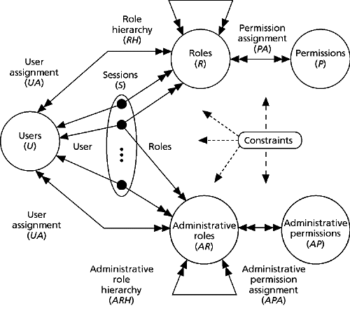
Role-Based Access Control
  It ensures that only authorized users are given access to certain data or resources.
  Many DBMSs have allowed the concept of roles, where privileges can be assigned to roles.
  Role hierarchy in RBAC is a natural way of organizing roles to reflect the organization’s lines of authority and responsibility.

Slide 16
Cryptography
  Symmetric encryption: DES and AES
    Confidentiality
  Asymmetric encryption: RSA and ECC
    Key agreement
  Digital Signature
    Integrity
    Non-repudiation

Slide 17
Summary
  Database Security and Authorization
  Discretionary Access Control
  Mandatory Access Control
  Role-Based Access Control
  Cryptography

